Slide 1
Network Design for Accounts and Delivery Department
By Mamatha.k

Slide 2
INTRODUCTION
This document describes the detailed process of designing, implementing, and verifying a network to connect the Accounts and Delivery departments. The objective is to establish efficient communication using appropriate hardware, IP addressing, and connectivity testing in Cisco Packet Tracer.

Slide 3
PROBLEM STATEMENT
The task is to design a network in Cisco Packet Tracer for the Accounts and Delivery departments that meets the following requirements.
1. Each department has at least 2 PCs.
2. The network includes a router and switches to connect the departments.
3. The IP address 192.168.40.0/24 is used for configuration.
4. Ensure seamless connectivity across all devices.

Slide 4
HARDWARE REQUIREMENTS
Hardware Requirements Table:
| Component | Quantity | Purpose
|
|--------------------|--------------|----------------------------------------------| | Router | 1 | Connects Accounts and Delivery departments. | | Switch | 2 | One for each department. | | PC | 4 | Two PCs per department. | | Ethernet Cables | 6 | Connects devices. |

Slide 5
IP ADDRESSING PLAN
| Device | IP Address | Subnet Mask | Default Gateway |
|---------------------|------------------|------------------|---------------------|
| Router (G0/0) | 192.168.40.1 | 255.255.255.0 | - |
| Accounts-PC1 | 192.168.40.2 | 255.255.255.0 | 192.168.40.1 |
| Accounts-PC2 | 192.168.40.3 | 255.255.255.0 | 192.168.40.1 |
| Delivery-PC1 | 192.168.40.4 | 255.255.255.0 | 192.168.40.1 |
| Delivery-PC2 | 192.168.40.5 | 255.255.255.0 | 192.168.40.1 |

Slide 6
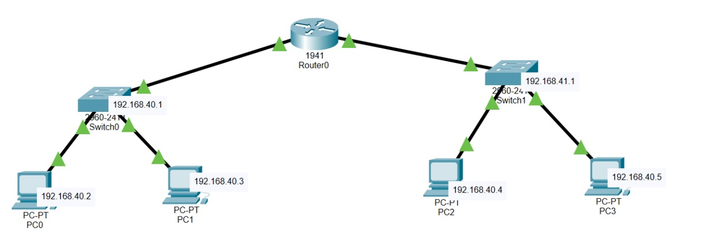
NETWORK DIAGRAM

Slide 7
STEPS TO IMPLEMENT
Physical Layout:
Add 1 Router, 2 Switches, and 4 PCs.
Connect PCs to switches and switches to the router.
IP Configuration:
Assign IP addresses based on the IP Addressing Plan.
Configure the router and PCs.
Testing:Use the ping command to verify connectivity.

Slide 8
PING TEST RESULTS
Ping Test Results Table:
| Source Device | Destination Device | Result |
|---------------------|------------------------|------------------|
| Accounts-PC1 | Accounts-PC2 | Successful | | Accounts-PC1 | Delivery-PC1 | Successful |
| Accounts-PC1 | Delivery-PC2 | Successful |
| Delivery-PC1 | Delivery-PC2 | Successful |

Slide 9
CONCLUSION
The network design meets the requirements for connecting the Accounts and Delivery departments.
IP configurations ensure smooth communication.
Ping tests verify successful connectivity.

